Slide 1
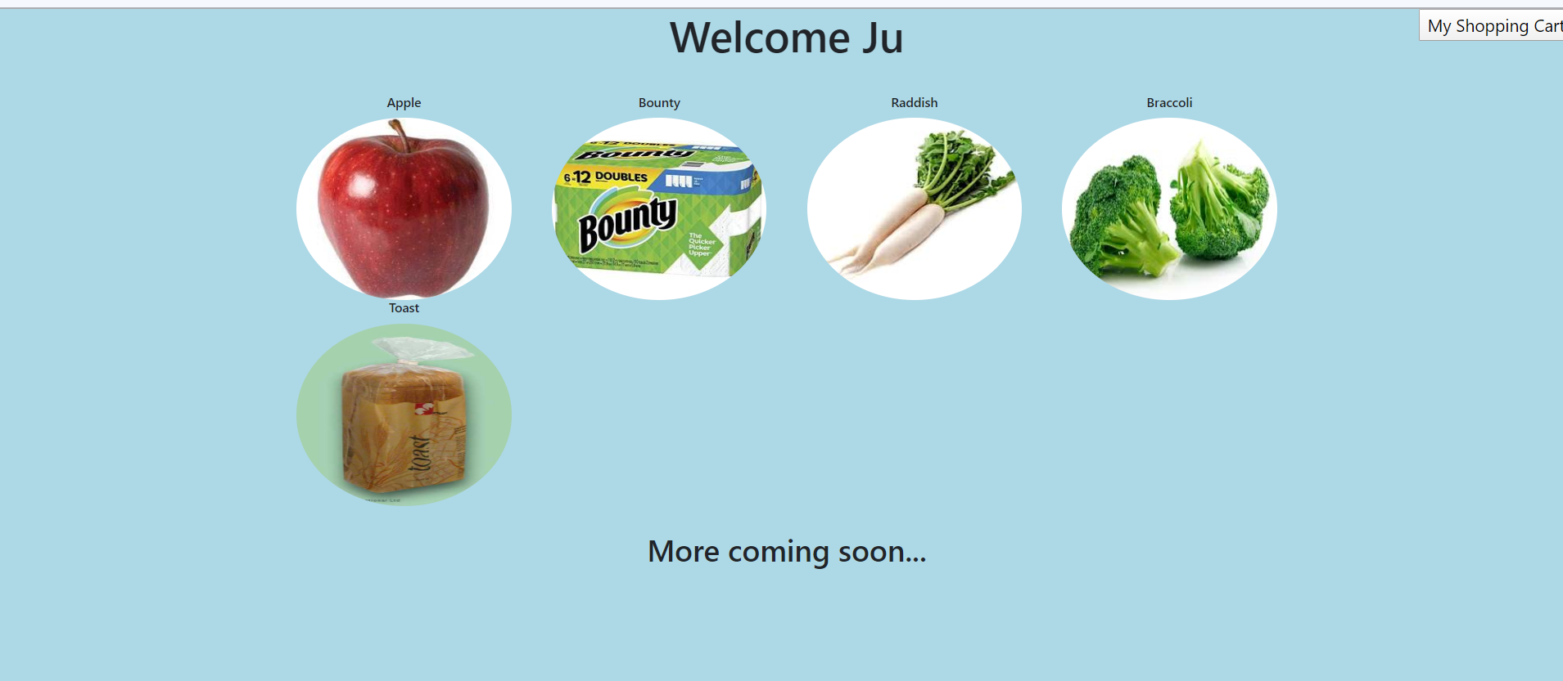
Online Market Database
Database Management CSCI 435 Professor Raman Kannan
Jinxiu Liu, Muskan Kapoor

Slide 2
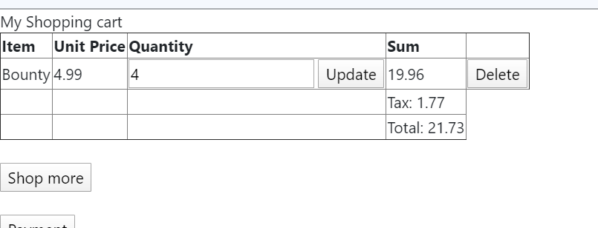
Problem Statement and What we Accomplished
Problem: How and what can we do to gain more profit in an online market? In order to solve any such problem, it is important to analyze and collect data.
In this web application, buyers are able to buy things by adding items in their shopping cart. Once they pay their items the system will be able to decrease the number of items in the market. Sellers will be able to add more items and the product details and the system will autumnally update the information. The data that we am collecting here is in regards to the items. Different items will have different prices and a specially generated code (or barcode) will help differentiate all these items. Use graphs to show when is profitable to import more items in stock

Slide 3
Initial Data Attributes and Information
barcode_id (ex: barcode id for apple is 1)
item_name (ex: apple)
img_url (ex: using url to get an image of an apple)
department (ex: apple is in Fruit Departement)
taxable (ex: apple is not taxable)
price (ex: how much is an apple: $0.6/each)
case_price (ex: a case of apple is 20 dollars)
num_lb_in_case (ex: how many pounds of radish in a case)
cases_in_stock (ex: how many cases of apples left in stock)
remain_not_in_case (ex: how many singles in stock, not including the cases)
company_info (ex: information about apple's importation)
username (ex: Ju)
Customer_id (customer id for Ju is 1)
customer_email (ex: yei@gmail.com)
password (ex: password for login)
phone (customer's phone number)
address (where customer live )
Purchase_id (ex: purchase number)
quantity (ex: I bought 5 apples )
payment_date (ex: I purchased 5 apples on 5/11/2020 at 12:12:12 )
total price (ex: total price for 5 apples)

Slide 4
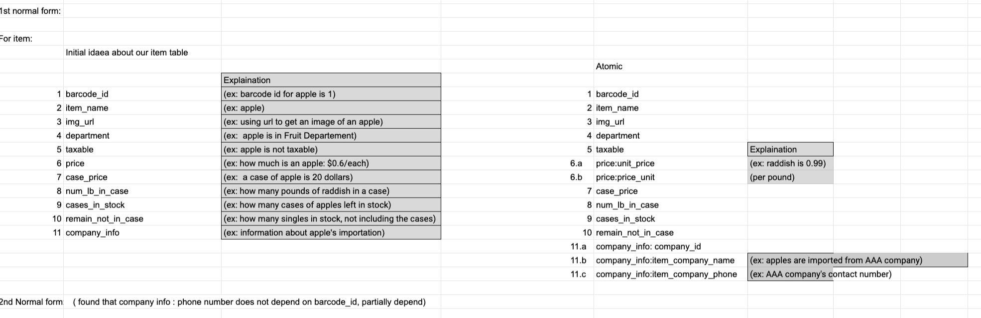
1NF for Items Table

Slide 5
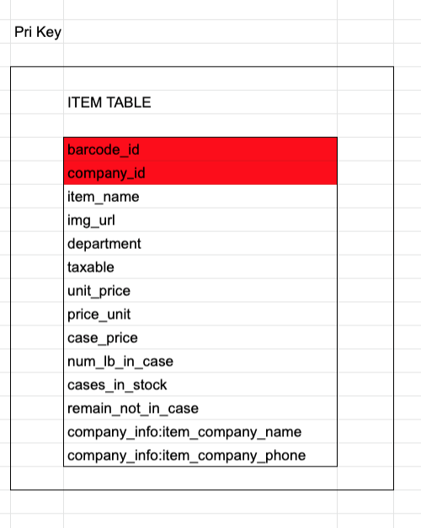
1NF for Items Table
There were no repeating groups

Slide 6
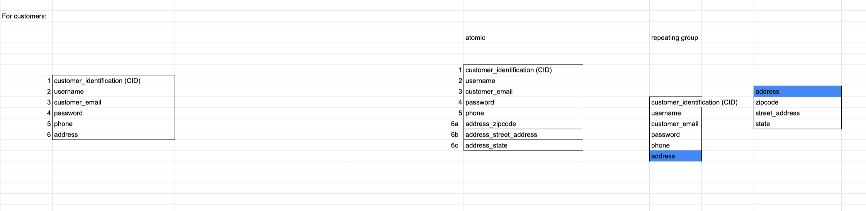
1NF for Customers Table

Slide 7
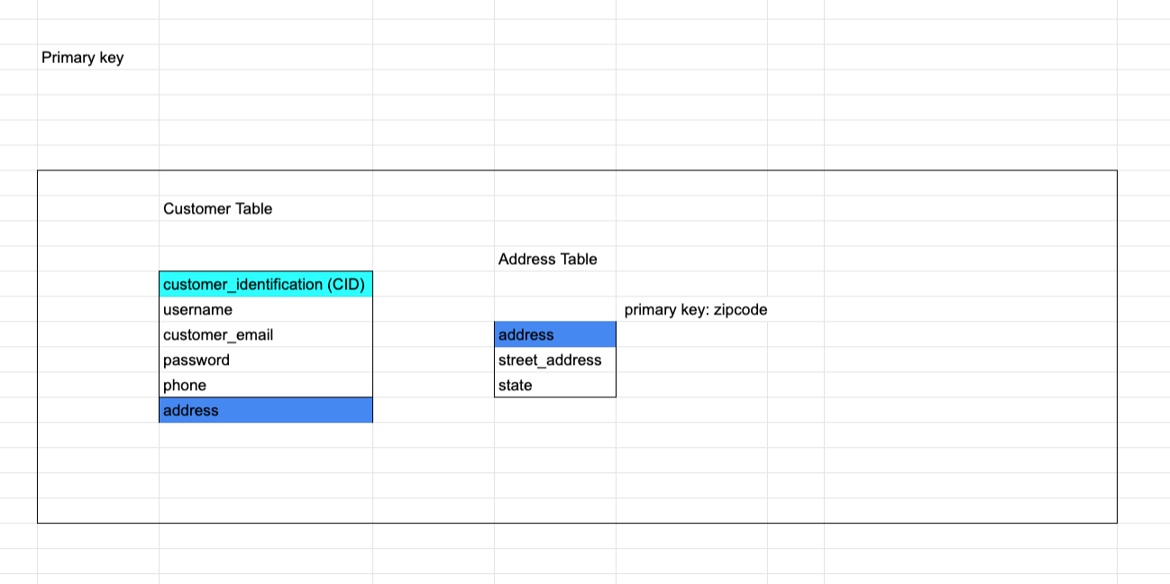
1NF for Customers Table

Slide 8
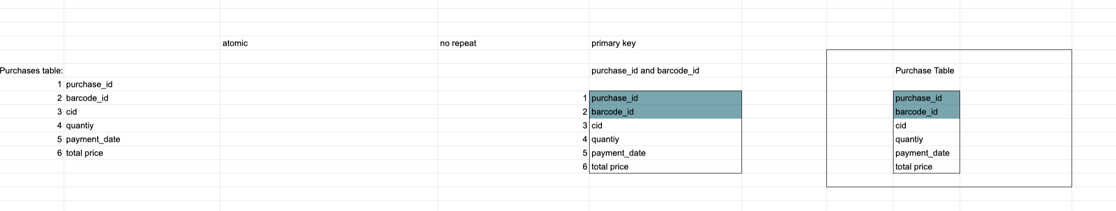
1NF for Purchase Table

Slide 9
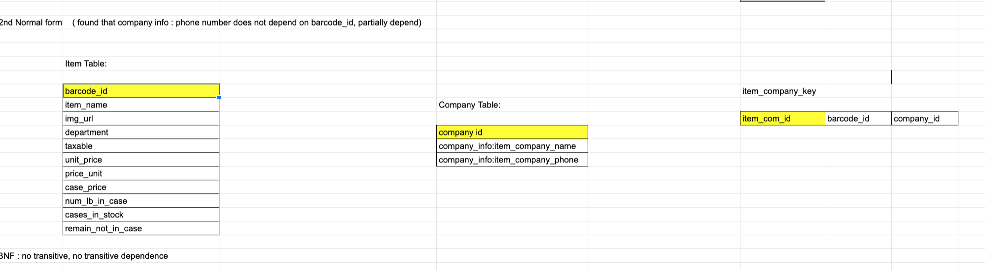
2NF - 3NF for Items Table
Notes:
https://docs.google.com/spreadsheets/d/1GvZ30OxdJ0NGI_018p_PIPFzGhNfb1ANlSUWpTMarjk/edit#gid=0

Slide 10
2NF - 3NF for Customers Table
For customer:
Customer Table
 |  | Address Table
customer_identification (CID)
username |  |  | primary key: zipcode
customer_email |  | address
password |  | street_address
phone |  | state
address
2NF | no compound primary key
3NF | no transitive, no transitive dependence

Slide 11
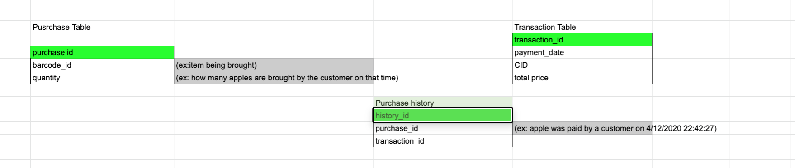
2NF - 3NF for Purchase Table
3NF: no transitive, no transitive dependence

Slide 12
Load Data (we create data ourselves)
First, we create tables
create table items (barcode_id int auto_increment primary key , item_name varchar(20), img_url varchar(200), department varchar(20), taxable varchar(5), unit_price double, price_unit varchar(5), case_price double, num_lb_in_case double, cases_in_stock int, remain_not_in_case double);
create table company(company_id int auto_increment primary key, item_company_name varchar(20), item_company_phone varchar (20));
create table item_company_key (item_com_key int auto_increment primary key, barcode_id int, company_id int);
create table customers (cid int auto_increment primary key, username varchar(20), email varchar(50), passowrd varchar(20), phone varchar(15));
create table address ( zipcode varchar(10) primary key, street_address varchar(50), state varchar(30) );
create table shoppingcart(cid int, barcode_id int, quantity double);
create table purchase (purchase_id int auto_increment primary key, barcode_id int, quantity double);
create table transaction (transaction_id int auto_increment primary key, cid int, payment_date timestamp default current_timestamp, total_price double);
create table purchase_history (purchase_history_id int auto_increment primary key, purchase_id int, transaction_id int);

Slide 13
Load data
Insert items into item table:
insert into items (item_name, img_url, department, taxable, unit_price, price_unit, case_price, num_lb_in_case, cases_in_stock, remain_not_in_case) values ('Apple' , 'https://encrypted-tbn0.gstatic.com/images?q=tbn%3AANd9GcSp89ikEgfC2Y5HxhUTB5Tz1ilCzCRIq8yY3UXt19BXahpghGTPm0Kr5l-ANN0Dlxg-IHSrqBNZ&usqp=CAc','Fruit' , 'No' , 0.6 ,'Each' , 16 , 30 , 25 , 18 ),('Bounty' ,'https://encrypted-tbn0.gstatic.com/images?q=tbn%3AANd9GcSiL4Gqt_Pmr5hXWxjakXdu0cDdVxGFvo7rOniatg9jtJ_xjpgL6H9wtNOvYAddjdoz5JmetRw&usqp=CAc','Grocery' , 'Yes' , 4.99 ,'Each' , 52 , 12 , 18 , 10 ),('Raddish' ,'https://encrypted-tbn0.gstatic.com/images?q=tbn%3AANd9GcRf0D--PDlAmJNTi-_z9rdSjlTZWcrziQWDCKuUpC_VTLYLdsV2&usqp=CAU', 'Veg' , 'No' , 1.29 ,'lb' , 23 , 20 , 12 ,15.27 ),('Braccoli' ,'https://encrypted-tbn0.gstatic.com/images?q=tbn%3AANd9GcQqqi9FXbF5W17YJWTK3OHB9YC_ZC7yK46PVLW-K1ybJczVLzOP&usqp=CAU', 'Veg' , 'No' , 1.99 ,'lb' , 35 , 20 , 10 , 5.3 ),('Toast' ,'https://www.jongerius-int.com/image/Toast-Speedbag10769_Cop5686.jpg', 'Grocery' , 'No' , 2.99 ,'Each' , 13.5 , 5 , 11 , 2 );
insert into company (item_company_name, item_company_phone) values ('AAA', '7189991011'),('BBB', '7182411013'),('CCC', '7189871837'),('DDD', '7180971011'),('EEE', '7180938761');
insert into item_company_key (barcode_id, company_id) values (1,1), (2,3), (4,5), (3,4), (5,2);

Slide 14
Queries Used
For month Graph:
select c.barcode_id as item, sum(c.quantity) as sum, c.date from (select barcode_id, quantity, DATE_FORMAT(payment_date, '%Y-%m') as date from transaction join purchase_history on transaction.transaction_id = purchase_history.transaction_id join purchase on purchase.purchase_id = purchase_history.purchase_id and barcode_id='4') as c group by c.date;
+------+------+---------+
| item | sum | date |
+------+------+---------+
| 4 | 7 | 2020-02 |
| 4 | 23 | 2020-03 |
| 4 | 13 | 2020-04 |
| 4 | 3 | 2020-05 |
+------+------+---------+

Slide 15
Queries Used
select barcode_id, quantity, DATE_FORMAT(payment_date, '%Y-%m') as date from transaction join purchase_history on transaction.transaction_id = purchase_history.transaction_id join purchase on purchase.purchase_id = purchase_history.purchase_id and barcode_id='4';
+------------+----------+---------+
| barcode_id | quantity | date |
+------------+----------+---------+
| 4 | 2 | 2020-04 |
| 4 | 3 | 2020-04 |
| 4 | 2 | 2020-04 |
| 4 | 6 | 2020-04 |
| 4 | 6 | 2020-03 |
| 4 | 6 | 2020-03 |
| 4 | 7 | 2020-02 |
| 4 | 11 | 2020-03 |
| 4 | 3 | 2020-05 |
+------------+----------+---------+

Slide 16
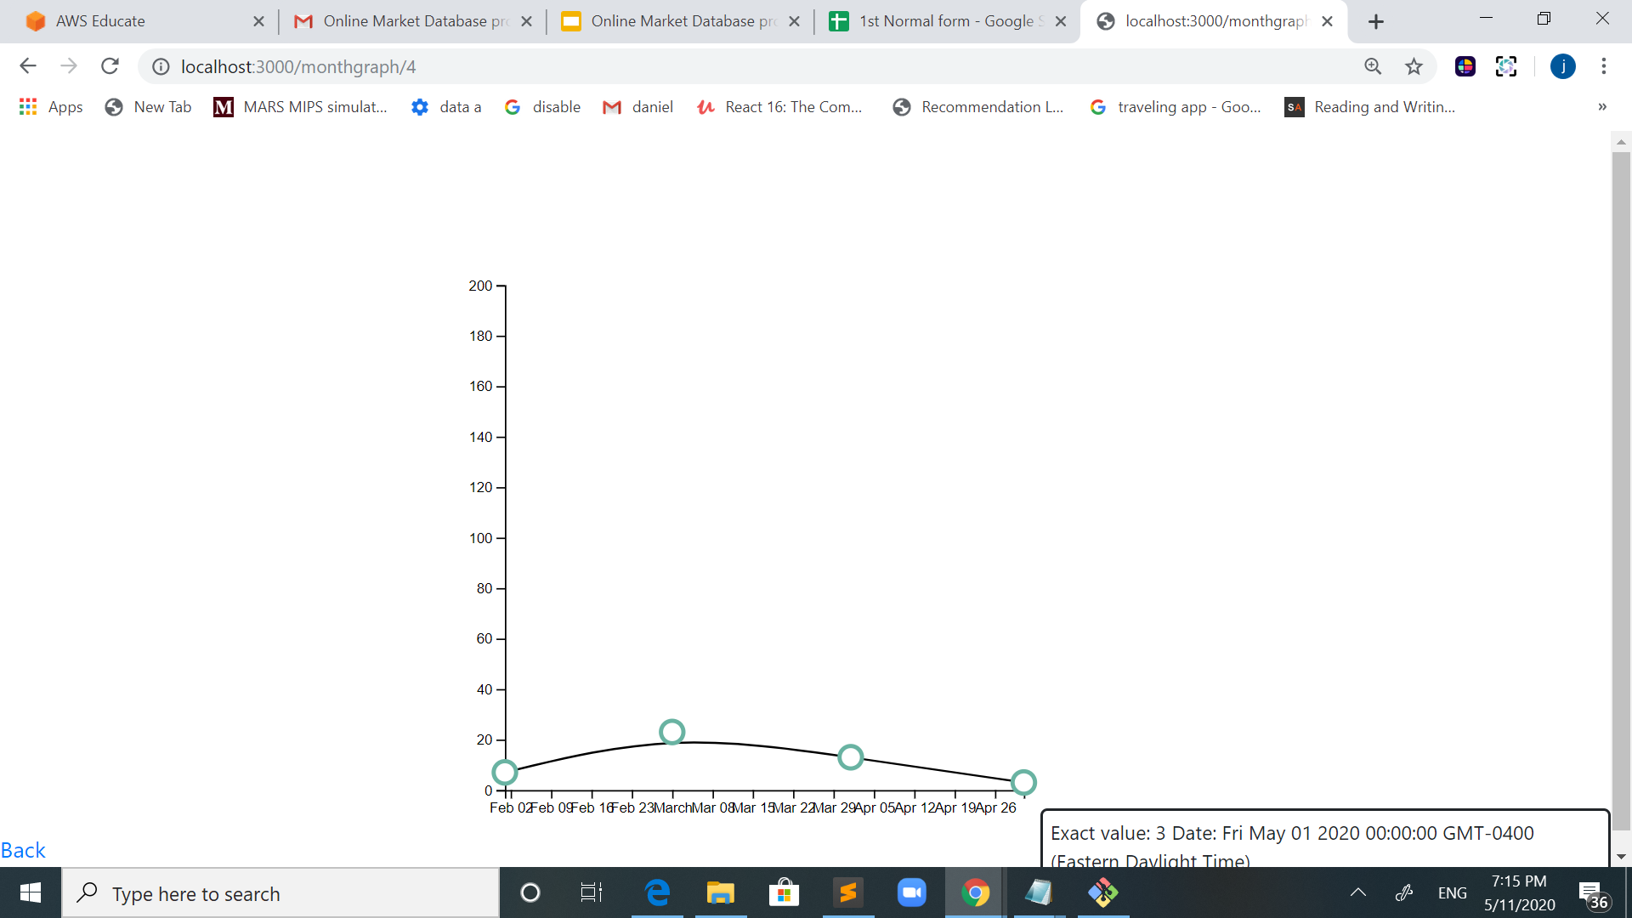
Picture of the Month Graph
3 pounds of broccoli were sold in may 2020, so far.

Slide 17
Queries Used
For daily Graph :
select c.barcode_id as item, sum(c.quantity) as sum, c.date from (select barcode_id, quantity, DATE_FORMAT(payment_date, '%Y-%m-%d') as date from transaction join purchase_history on transaction.transaction_id = purchase_history.transaction_id join purchase on purchase.purchase_id = purchase_history.purchase_id and barcode_id='4' and (transaction.payment_date BETWEEN '2020-04-15' AND '2020-04-30')) as c group by c.date;
+------+------+------------+
| item | sum | date |
+------+------+------------+
| 4 | 8 | 2020-04-23 |
| 4 | 5 | 2020-04-26 |
+------+------+------------+

Slide 18
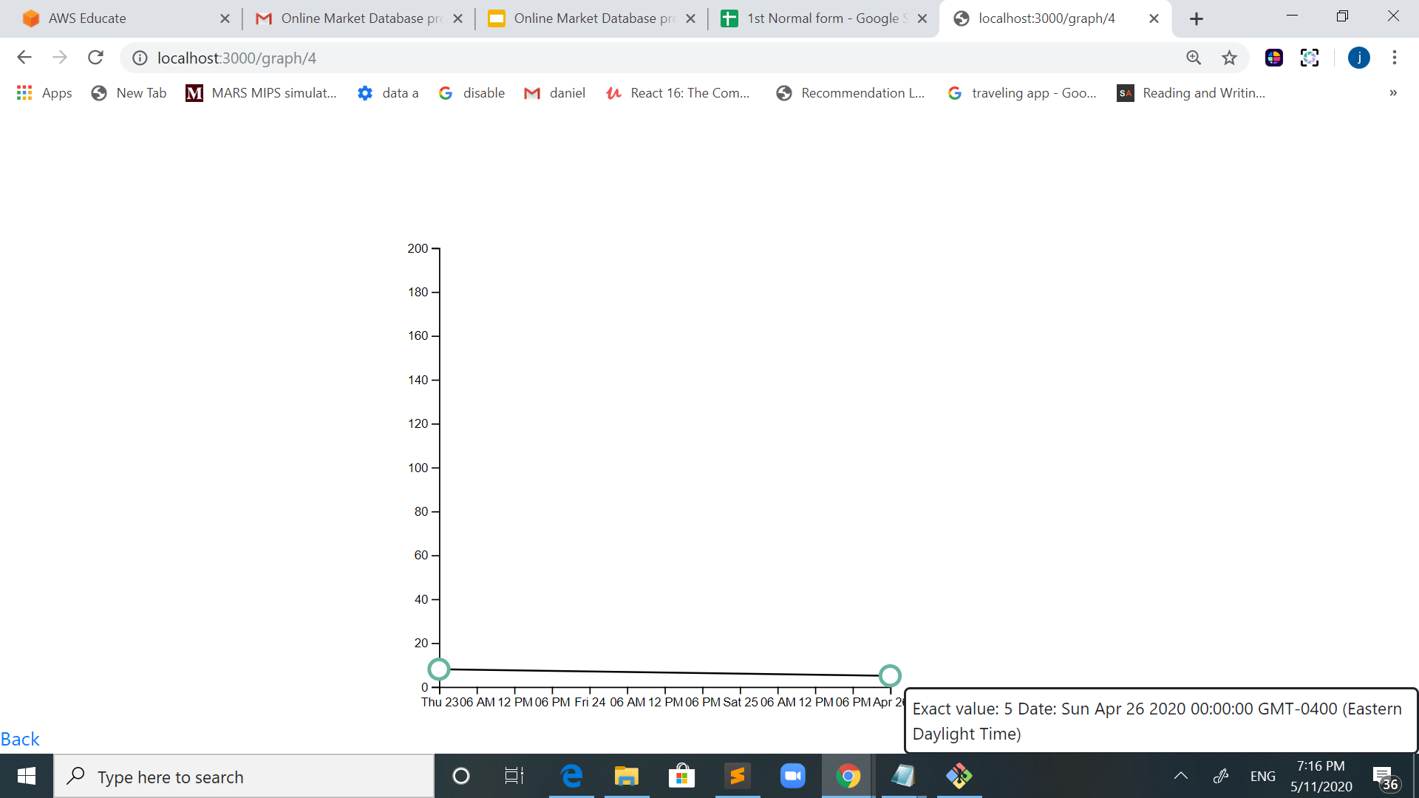
Daily graph
5 pounds of broccoli were sold on April 26th 2020

Slide 19
Other Queries used
To update items in stock after a customer pays:
UPDATE items SET cases_in_stock= 14 where item_name='Bounty’;
To add more items in stock after new importation:
UPDATE items SET cases_in_stock= 20 where barcode_id=4;

Slide 20
Tools / technologies:
Cloud platform: AWS Cloud
To build web app, we use:
Node js, mysql, express-handlebars, git/github, javascript, css

Slide 21
Problems / Difficulties Faced
AWS credit is limited, AWS database access is limited
Problems with asynchronous in using javascript
Normalization! This was not exactly a problem. But we definitely spend the core part of our project focusing on perfecting and refining this process

Slide 22
THANK YOU!
IBM Cloud sponsored by Power Systems Academic Initiative
Thank you Professor
Thank you classmates

